Slide 1
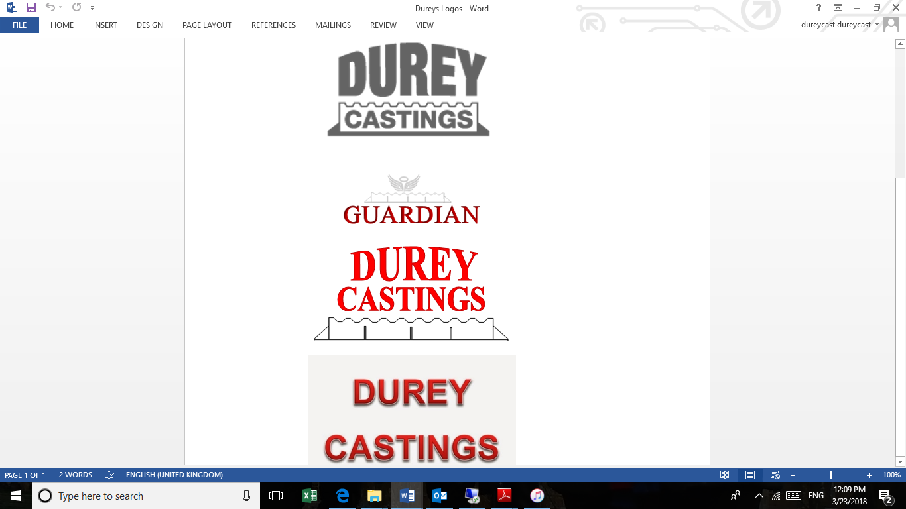
PIPE CROSSINGS AND PIPE BRIDGES RISK ASSESSMENT
Control Measures

Slide 2
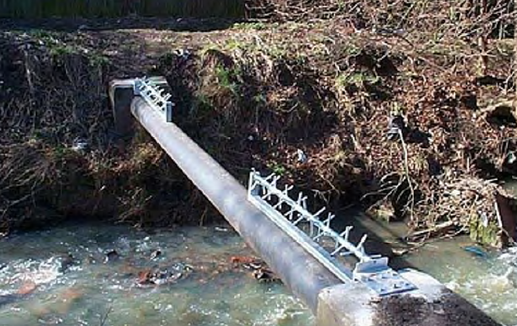
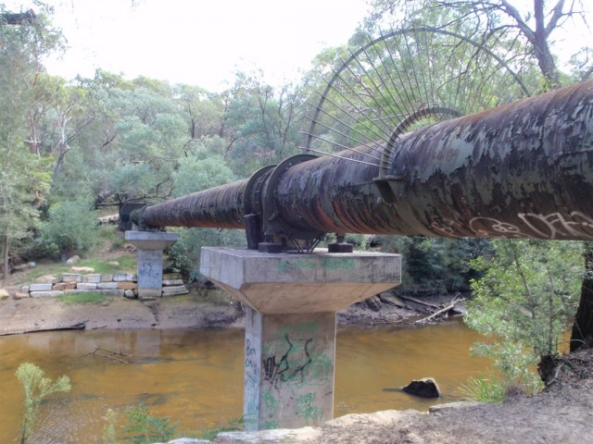

Slide 3
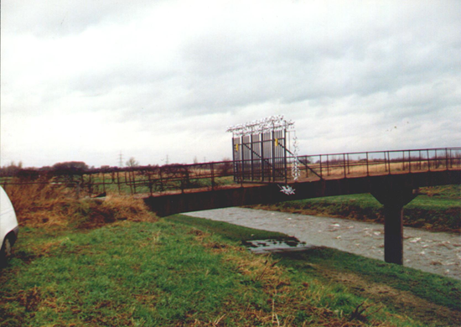
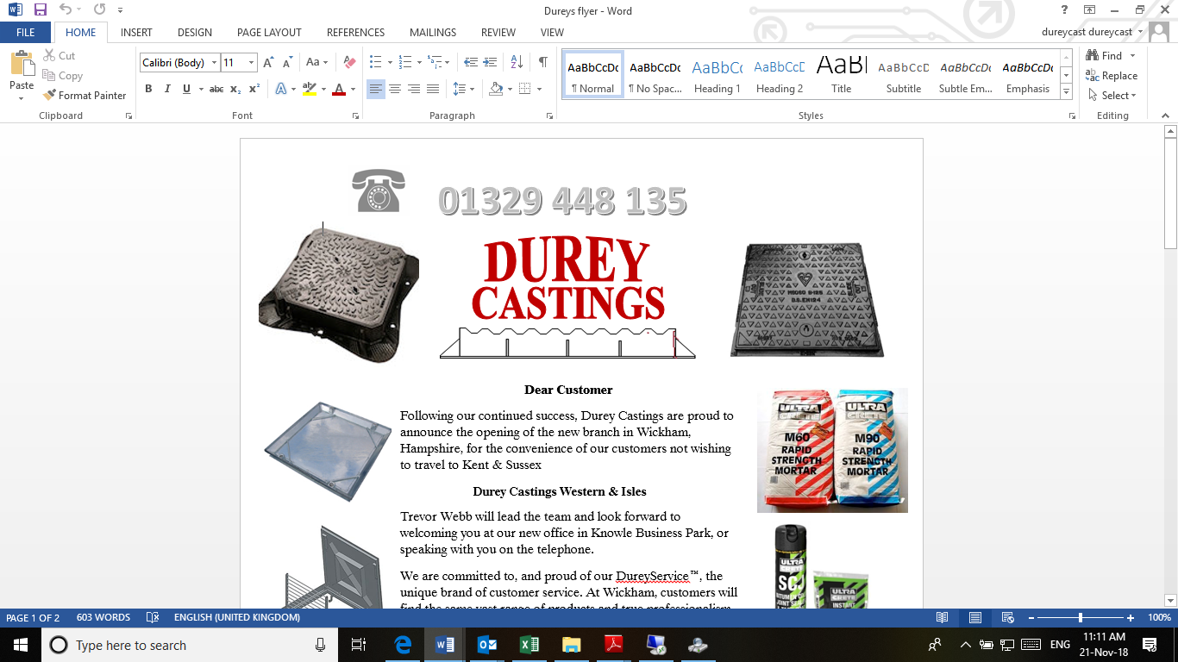

VanDGard Anti Climb
Anti climb added to gates and fan style barriers
Insert Product Photograph Here

Slide 4
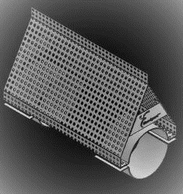
The Witches Hat
An Access Deterrent Measure for exposed Pipelines and Crossings.
Available to suit varying pipe sizes from 80mm to 1500mm or more
This unique system safely deters children and adults from climbing across pipelines or using them as a walkway
The Witches Hat system is designed to reduce pressure on the pipe in flood conditions and eliminate condensation which might otherwise cause corrosion

Slide 5
VanDGard Anti Climb
Insert Product Photograph Here

Slide 6
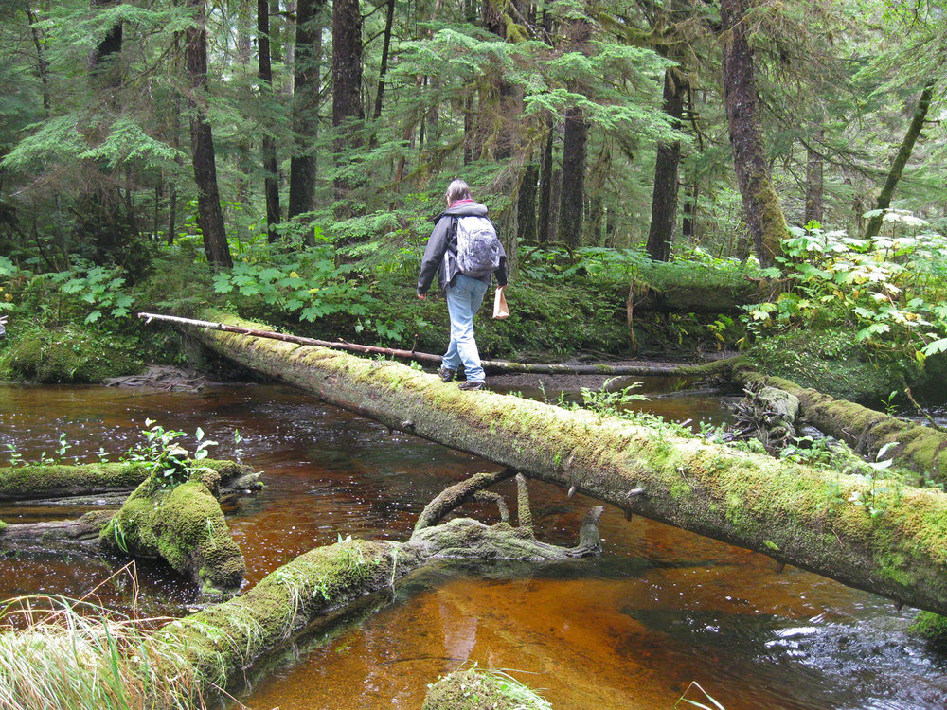
Overview
VanDGard “Safe Edge ® ” is designed to be safely used at low level. Principally to protect exposed pipes and cables that might be used as a walkway

Slide 7
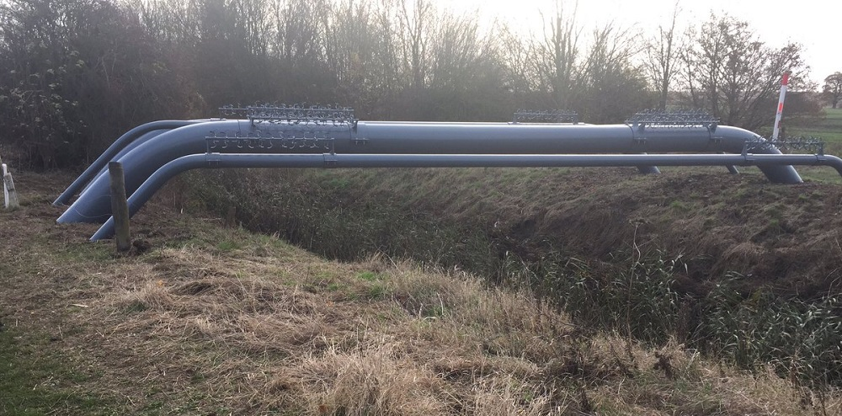
Features & Benefits
VanDGard “Safe Edge ® ” is larger diameter than any other anti climb obstacle
No trip
Safe product

Slide 8
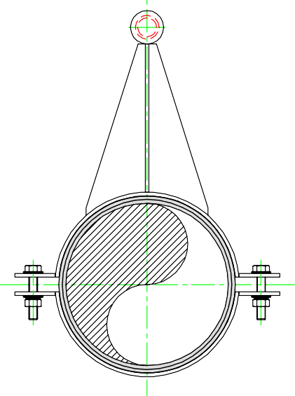
maximum 2m
(OVERALL ASSEMBLY LENGTH)
(see note 5)
1" Dia x 0.081 w/t. St. Steel Tube
2
3
2
4
1
Assembly Type 'S' Details for 1 off 1m Length Assembly
see Sheet 2 for Multiple Lengths to suit 80 - 300NB Steel Pipe Scale 1:5
1
Note:
All bolts, nuts and washers to be zinc plated.
All Steelwork fabrication to be in accordance with client standards
Oilite Bearing Item 2 to be held in place using an Appropriate Adhesive.
Vandgard® 'Safe Edge' spinners having a uniform textured edges with no dangerous, sharp or jagged burrs.
Maximum length of spinners is 2m

Slide 9
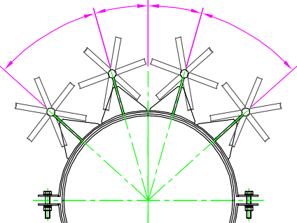
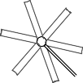
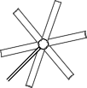




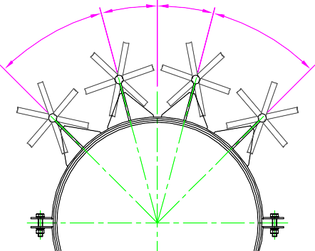
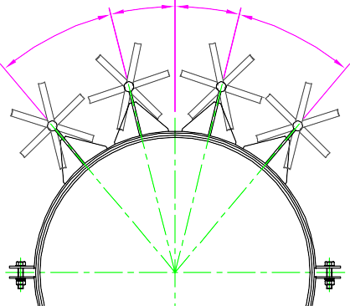


A2/15/1389
380NB - 1200NB Steel Pipe Clamp Assembly Type 'S'
45°
45°
36°
36°
32°
16°
16°
32°
2
3
5
4
for 380NB to 450NB
for 600NB
for 750NB
15°
15°
14°
14°
for 900NB
1
6
30°
30°
26°
26°
No. of Spinner Assemblies per NB requirement
Quantities should be adjusted to suit Scale 1:20
for 1050NB
for 1200NB
Assembly Type 'S' Details
for 1 off Extra Assembly to suit 380 - 1200NB Steel Pipe Scale 1:10
380NB - 1200NB GENERIC TABLE for Item 6 Neoprene Length
 | Item 6 (Neoprene Length)
380NB | 590
400NB | 630
450NB | 710
600NB | 950
750NB | 1190
900NB | 1425
1050NB | 1660
1200NB | 1900

Slide 10
Features & Benefits
VanDGard “Safe edge ®” is made with a sandpaper textured edge 1.7mm wide. Safe, but suitably uncomfortable to touch.
VanDGard “Safe Edge ®” is made from a bespoke extrusion
Cost savings
Safe product

Slide 11
Features & Benefits
The Most Effective Access Prevention
Rotates in Flood conditions to dislodge debris
VanDGard “Safe Edge®” is easy to fix
Provided as a complete kit
Inert materials
Bespoke clamp support brackets

Slide 12
Applications
Applications include all situations where vandalism or theft is likely and particularly where public liability Legislation applies
Pipes, cable bridges, walkways Fences Gates vehicle parking areas domestic sport and leisure areas

Slide 13
Specifications
Support Clamp brackets 5mm steel laser cut ,folded, welded.
Stainless shaft, Aluminium Vanes
Stainless housing, Oilite Bearing
10mm Neoprene lining
Galvanised / PPC options

Slide 14
Specifications
Weight: 2.80kg per metre
(excludes Clamp brackets)
Available in aluminium

Slide 15
Key Points
Secure Access Prevention
No trip, No impaling hazard
Safe
Proven
Cost effective

Slide 16
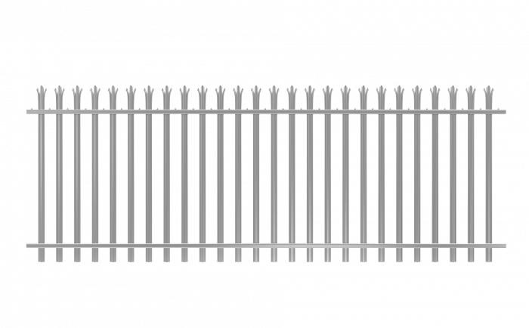
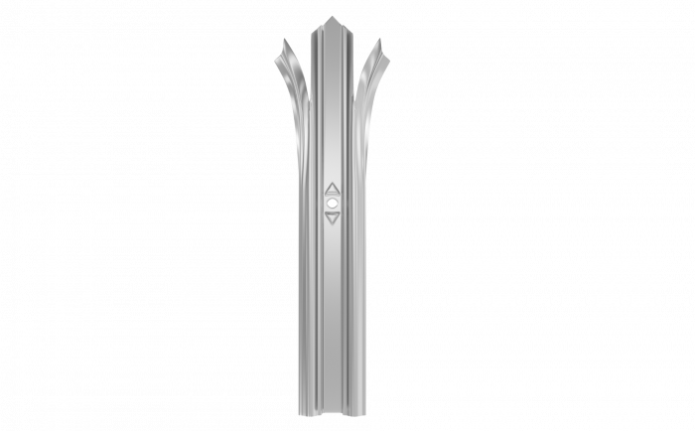
Palisade Fencing
Palisade Fencing is suitable for a variety of outdoor locations where a medium level of security is required. Designed for permanent installation, Palisade Fencing is extremely robust and resilient and is often a popular choice of security fencing for industrial and commercial buildings, as well as public areas.
Made from cold rolled steel, this 1.8m high Fencing offers great strength and is supplied with a protective galvanised finish, to help prevent rust. The pales have a ‘w’ shape profile which makes it very difficult for people to grip onto the Palisade Fencing. The Palisade Fencing also have triple pointed heads, which helps to prevent climbing activity.

Slide 17
KEY FEATURES
Steel Galvanised to BS EN ISO 1461:2009
‘W’ Section Pales
Robust
Reliable site security
Install on hard or soft ground types
Permanent and Durable
Intimidating and Anti-Climb design
High level of security

Slide 18
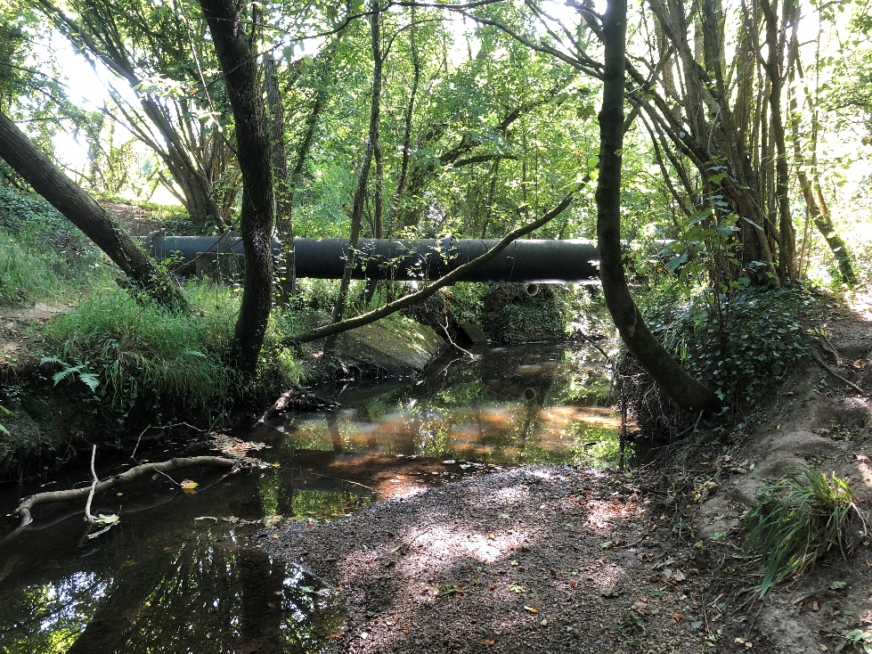
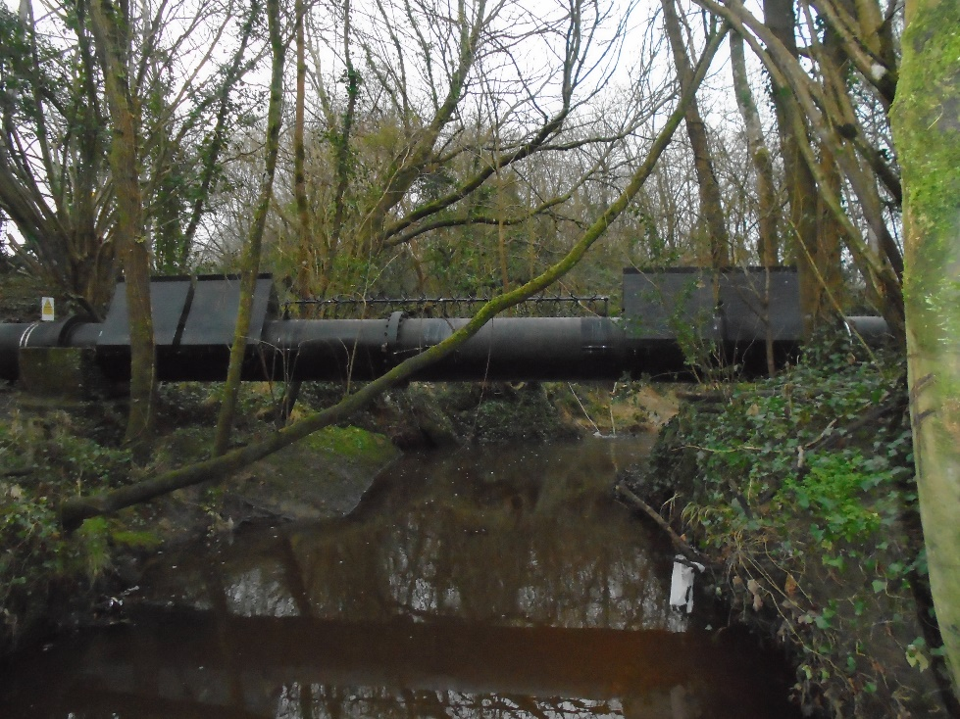
A Rural Site In Hampshire – Witches Hats & Safe Edge ® protection
Before After
Both Products powder coated in matt black

Slide 19
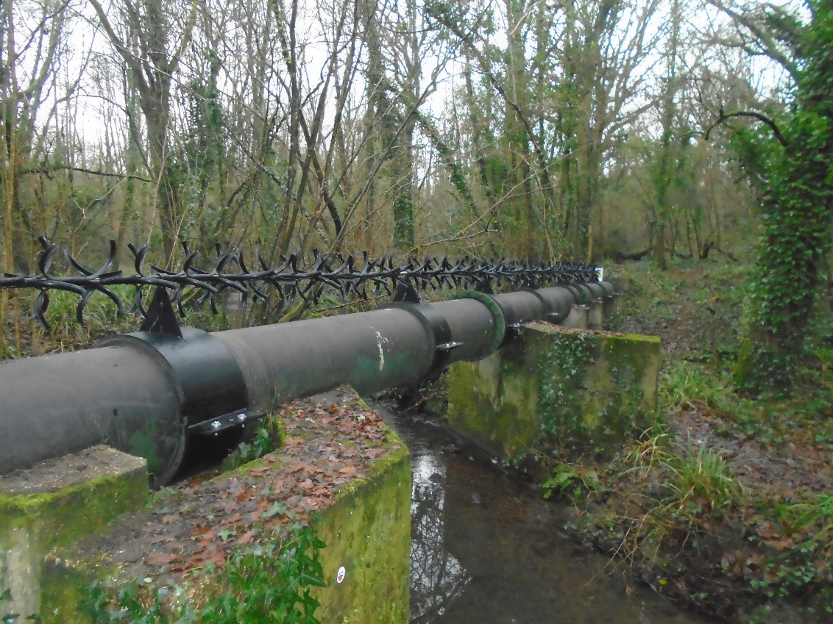
A Rural Site near a public footway in West Sussex
Before After
Matt Black Powder Coated Safe Edge®

Slide 20
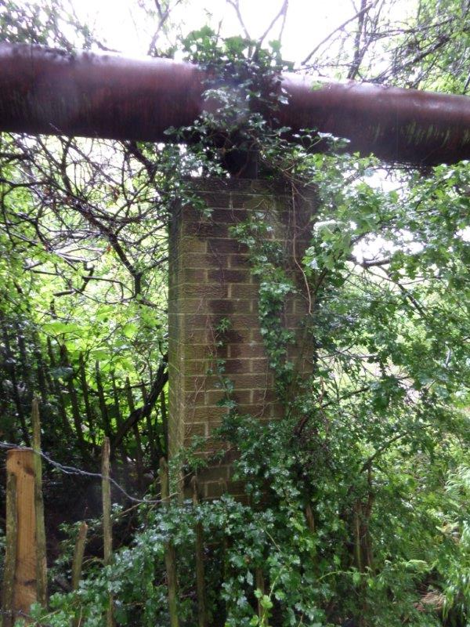
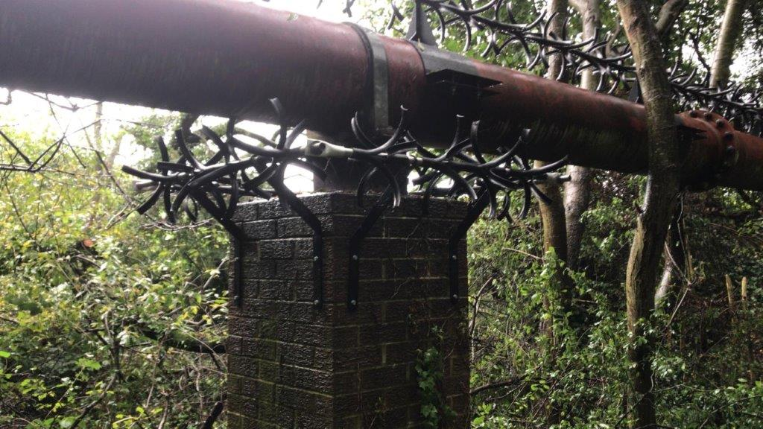
Pipe Bridge suspended on Brick Pillars – Safe Edge® Pillar Protection
Before After
Matt Black Powder Coated Safe Edge®

Slide 21

Vandgard® Said
“Our Partners and Distributors are crucial to get the product to the end user and to help level out the peaks of supply and demand, Vandgard® has helping hands through agreements with specialists that display and promote their products, receive and process orders, and deliver on time.”
Durey Castings Ltd. Said
“ As a successful specialist manufacturer ,Stockiest and Distributor of all types of manhole cover ,gully grates and duct covers, since 1975 ,our products are used in all areas of construction. Our BSI accreditation audit always encourages new product development , We are proud to be in partnership with Vandgard, using our contacts and knowledge from our long term relationships with the water authorities , we hope to grow this supply chain & partnership .”

